Slide 1
Signature-less Threat Detection: Mining Microbehaviors to Detect Ransomware (Aktaion)
Joseph Zadeh @josephzadeh
Rod Soto @rodsoto

Slide 2
$Whoami
Rod Soto
Director of Research at JASK.AI, former SPLUNK, AKAMAI, Prolexic PLXSert Principal Researcher. Like to break things, p0wn botnets and play CTFs.
Joseph Zadeh
Data Scientist at JASK.AI, building behavioral intrusion detection technologies at scale. Enjoy working on defense projects that combine security, artificial intelligence and distributed systems
Aktaion Current Project Home Page:
https://github.com/jzadeh/aktaion
https://github.com/jzadeh/aktaion2

Slide 3
Introduction

Slide 4
Expressing Microbehaviors in Code: Aktaion V2
https://github.com/jzadeh/aktaion2/tree/blackhat_eu_2017 (careful not merged into master until EOW for now use the following for access)
git clone https://github.com/jzadeh/aktaion2.git
git checkout origin blackhat_eu_2017
Migrated Core Logic and Modules to Python3 Implementation
aktaion2/python
./run_ml.sh : builds machine learning ready data sets given input directories and window sizes and config parameters
./run_aktaion2.sh : use to reproduce what you see in the arsenal demo and score individual files
aktaion2/python/research_dev/random_forest:
micro_beahvior_core_logic.py : key abstraction used for building important characteristics about attack/benign in a form useful for AI to learn from
rf_v2.py, svm.py, calibration.py : main machine learning based tools using Random Forest, Support Vector Machine and Classifier performance analysis

Slide 5
Introduction
Crypto Ransomware has become an increasing attack vector used by malicious actors to quickly turn infections into profits.
Current state of threat detection technologies is based on static signature approach applied to executing binaries.
This approach is insufficient and inefficient protecting victims against this type of threat as malicious actors will apply obfuscation and user deceiving techniques that easily bypass static signature based defense technologies

Slide 6
Introduction
A novel approach against this threat using Machine Learning algorithms provides a framework to approach ransomware without depending on static signature, basing its detection on contextual indicators and micro behaviors of such type of malware.

Slide 7
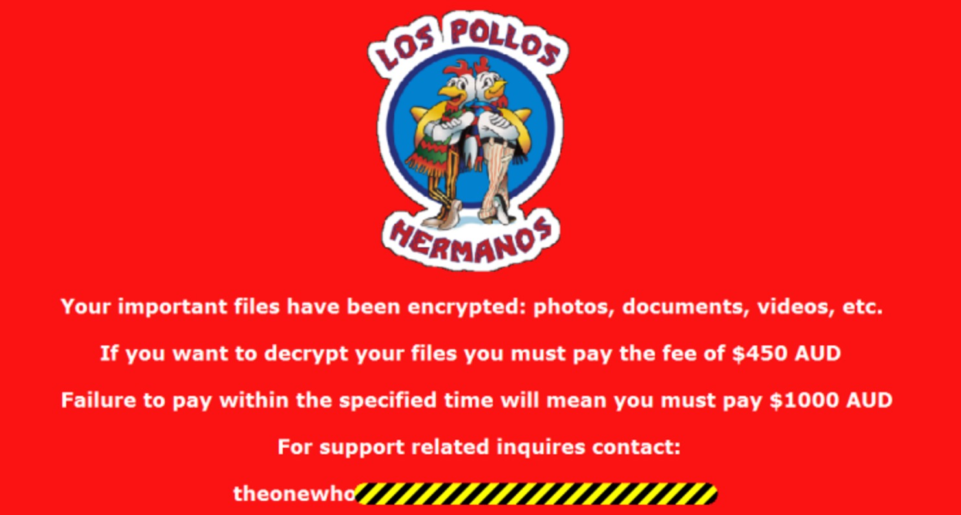
What is Ransomware?

Slide 8
What is Ransomware
Ransomware is a type of malware that can be covertly installed on a computer without knowledge or intention of the user that restricts access to the infected computer system in some way,[1] and demands that the user pay a ransom to the malware operators to remove the restriction. * Wikipedia

Slide 9
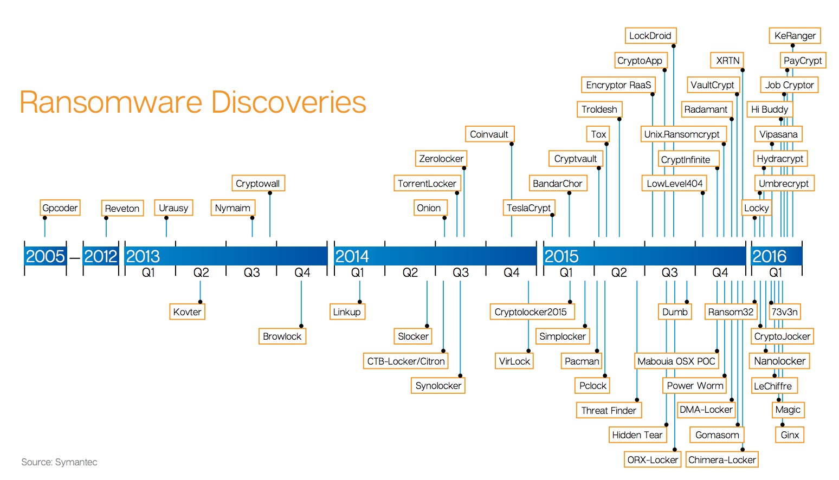
What is Ransomware

Slide 10
Ransomware IOCs
The modification of the registry keys (Most associated with persistence. I.E execute after reboot).
Renames and encrypts file extensions of files (Targets User’s docs. I.E .doc, xls, ppt, mp3, wallet).
Modifies Master Boot Record to prevent rebooting, usually encrypting it relocating it and placing a replacement.
Removal of Volume Snapshot Service files (VSS) or volume shadow files, use for system restoration and backup
Encryption of map and unmapped network shares with write permission.
Some variants show outbound connection to Command & Control Server (C2). In some cases TOR traffic is observed. Notice that not all variants of ransomware present C2 communications.
Use of RSA encryption (2048,9046) *, AES encryption algorithm.

Slide 11
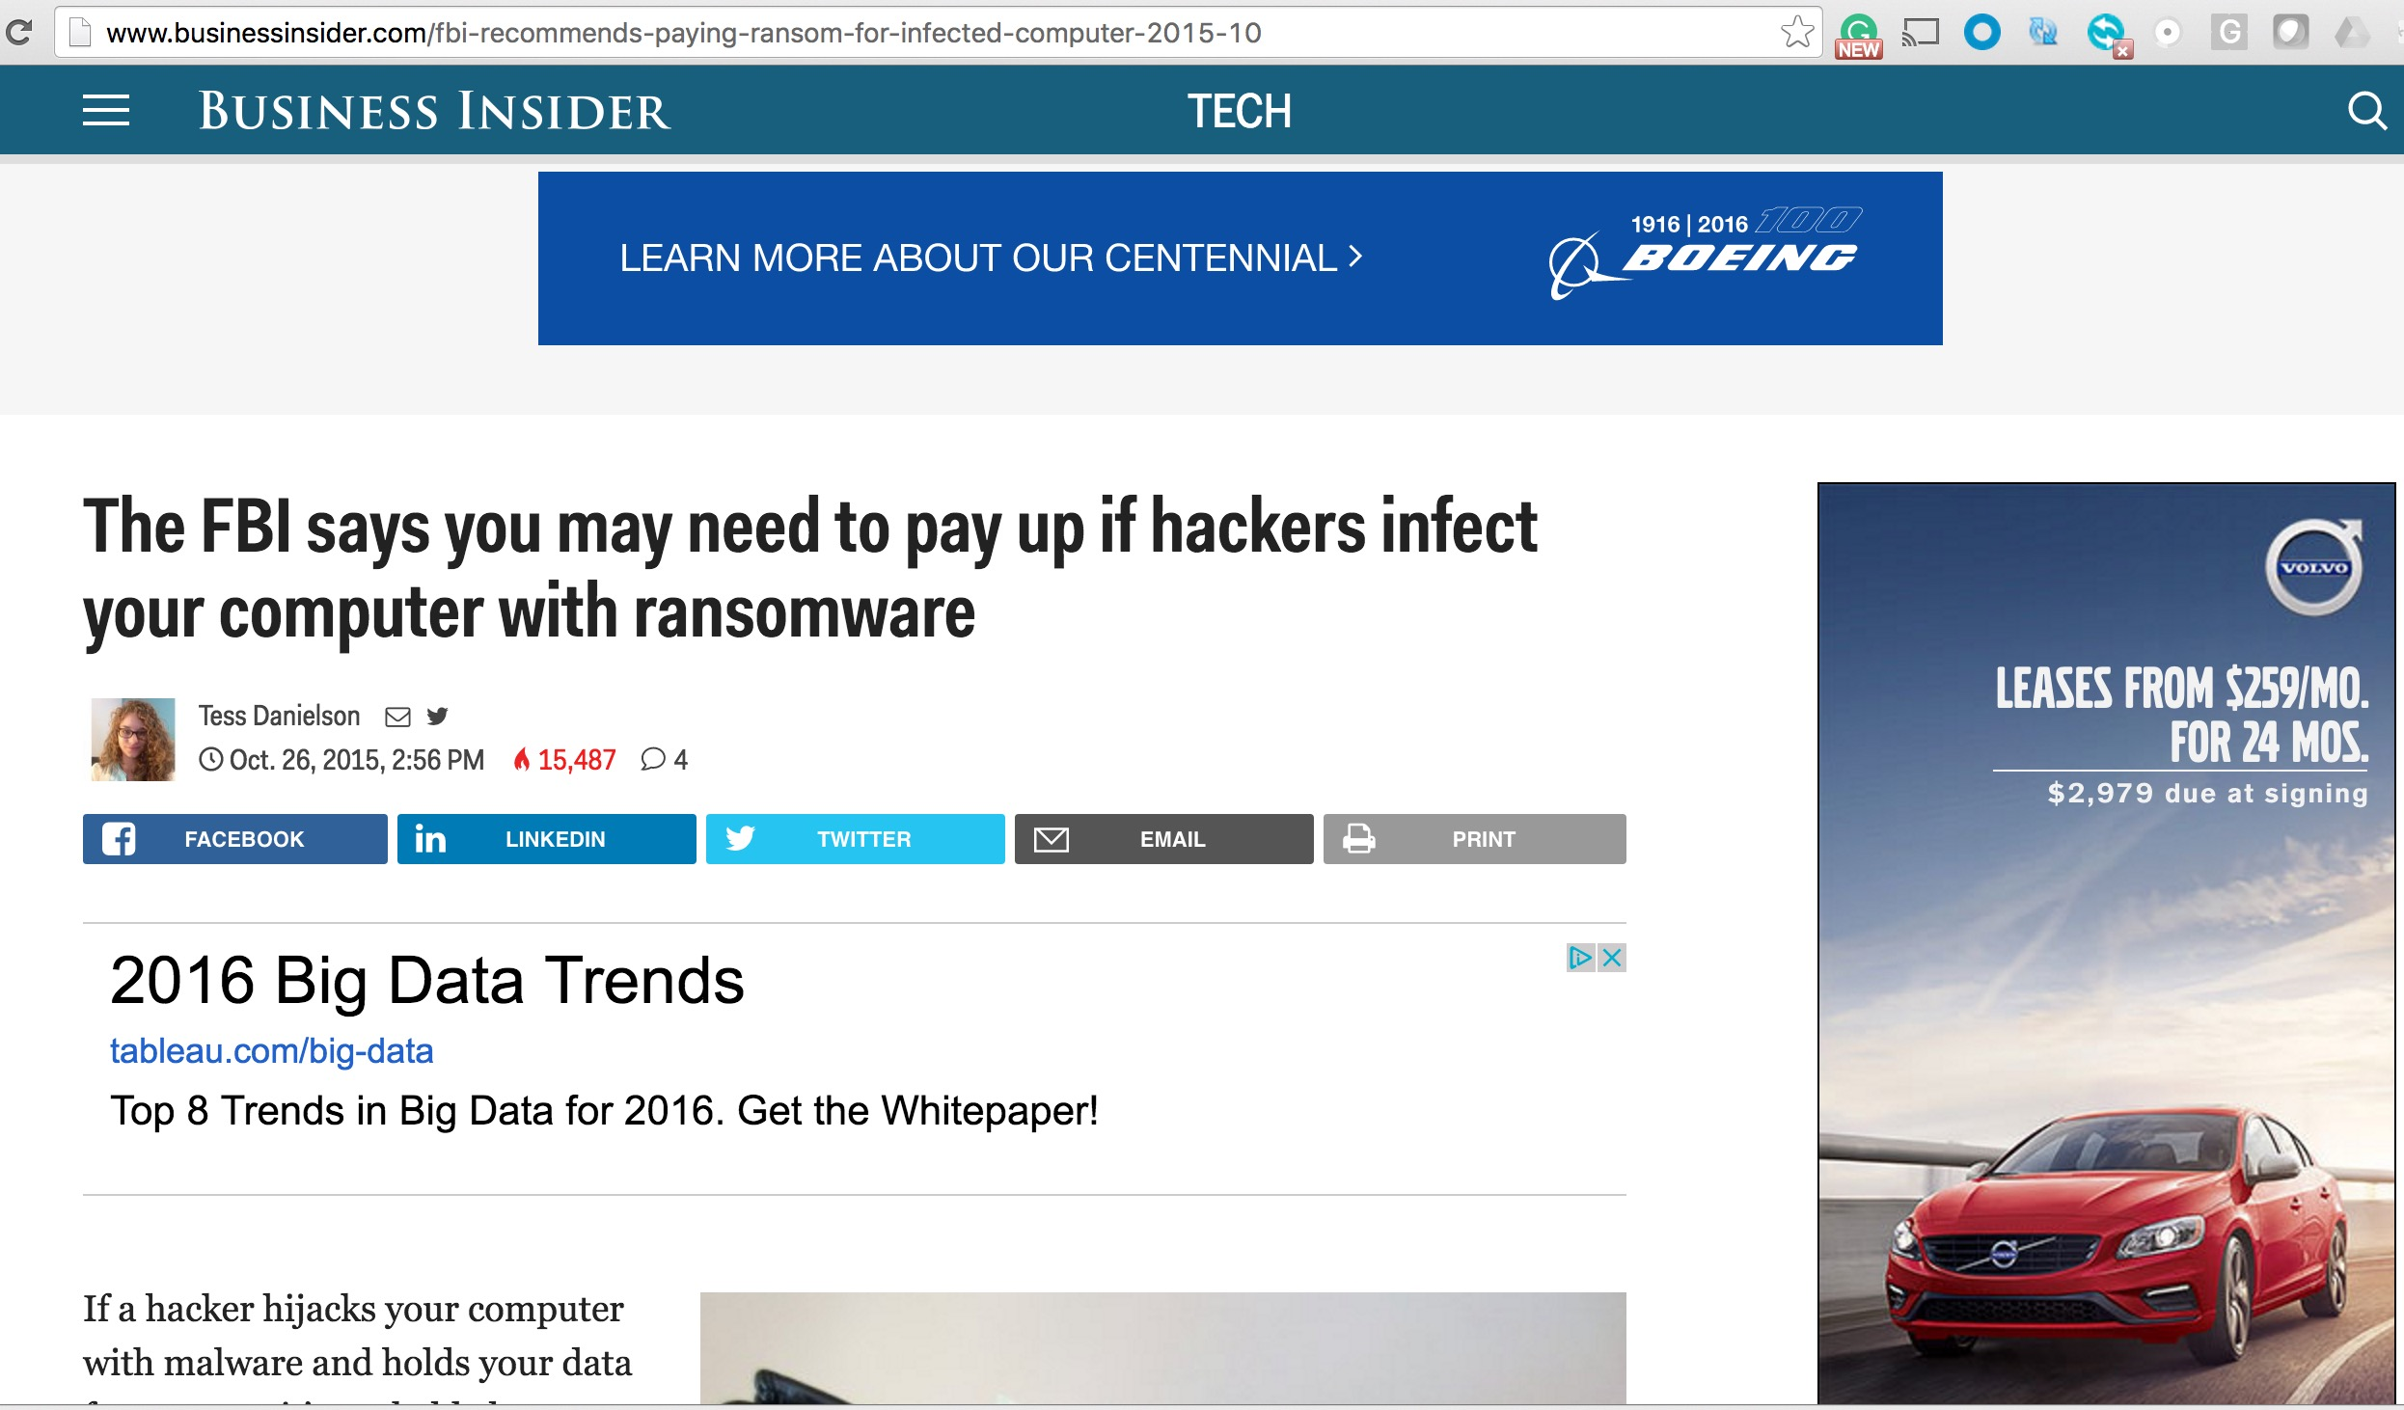
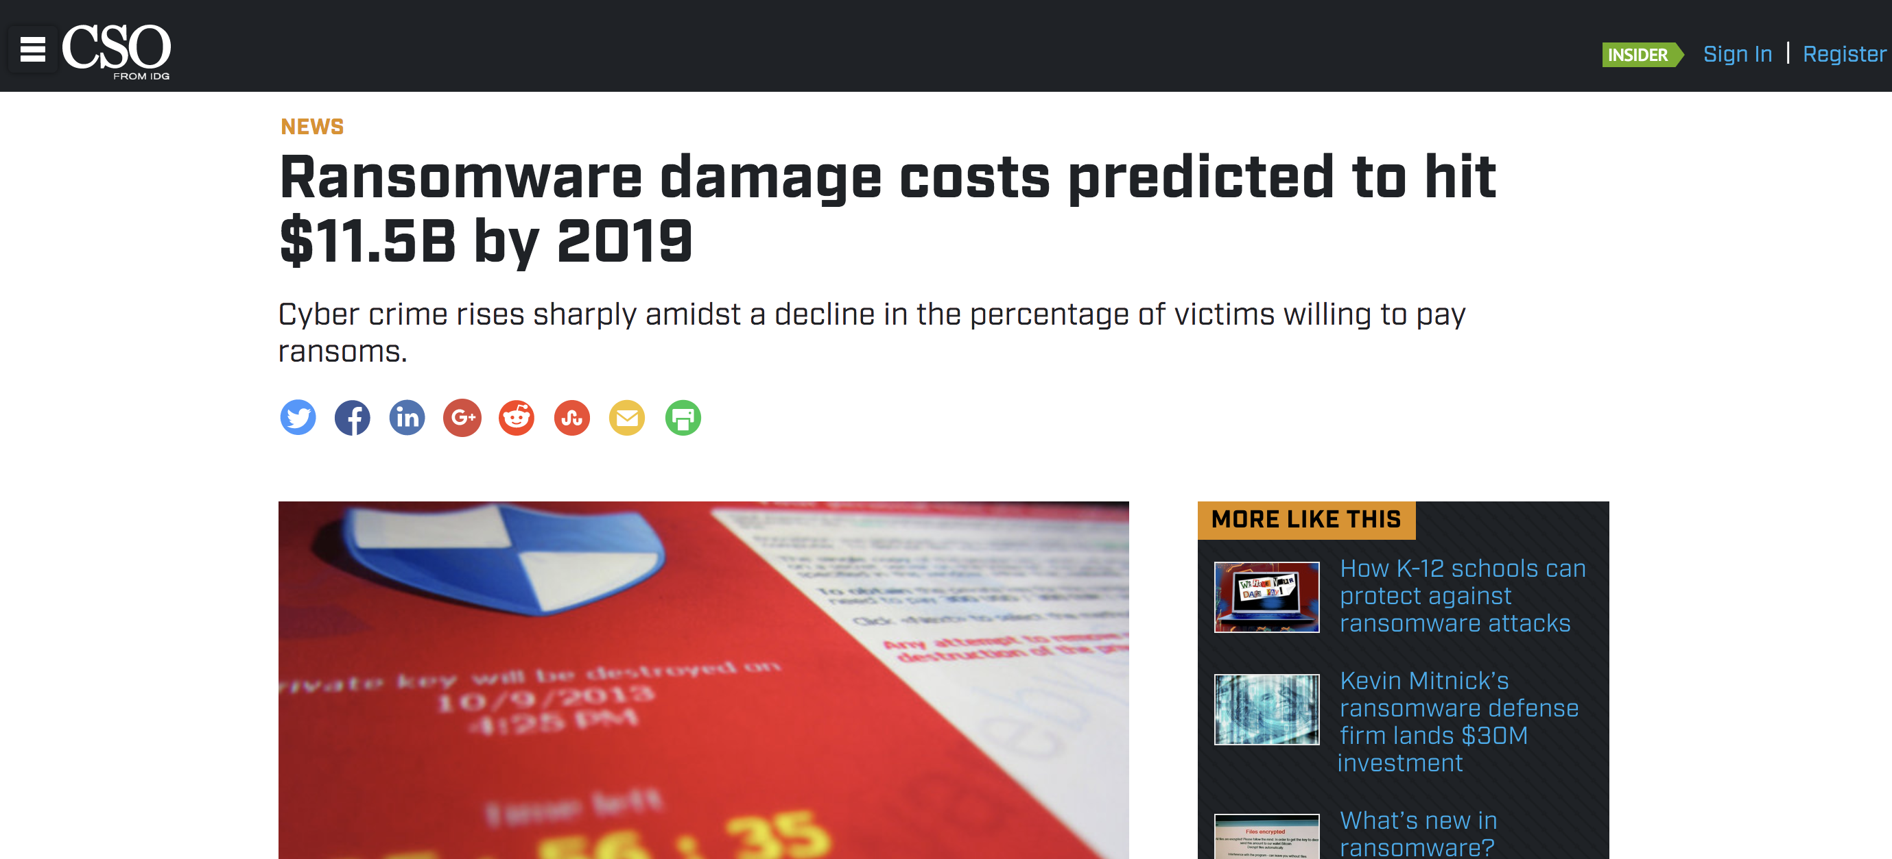
What is Ransomware and why are victims paying?

Slide 12
Current Ransomware Threatscape
Ransomware malware cost $18 million in loses according to FBI. (Each time cost between $200 & 10K). 11.5 Billion by 2019 (Update)
Attacks targeting individuals and organizations, HealthCare & Utilities present a concerning example of real life consequences on human well beings.
Attacks continue increasing due to successful infestation and ransom cash out.
Adversarial shift shows current defense technologies are insufficient.
Crypto ransomware payload being used as post exploitation payloads in EK such as Zeus, Drydex, Neutrino, etc.
Monetization expanding further (Ransomware as a Service)
Bitcoin/TOR unfortunately an enablers of this modus operandi
In some cases they are used as a SHROUD to cover destructive targeted campaigns (NotPetya, BadRabbit)

Slide 13
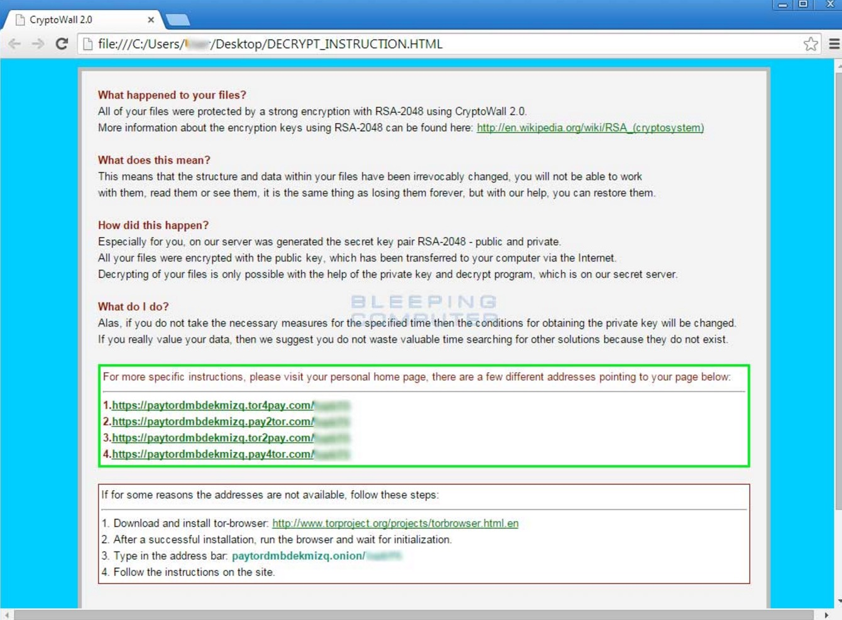
TOR unfortunately a crime enabler

Slide 14
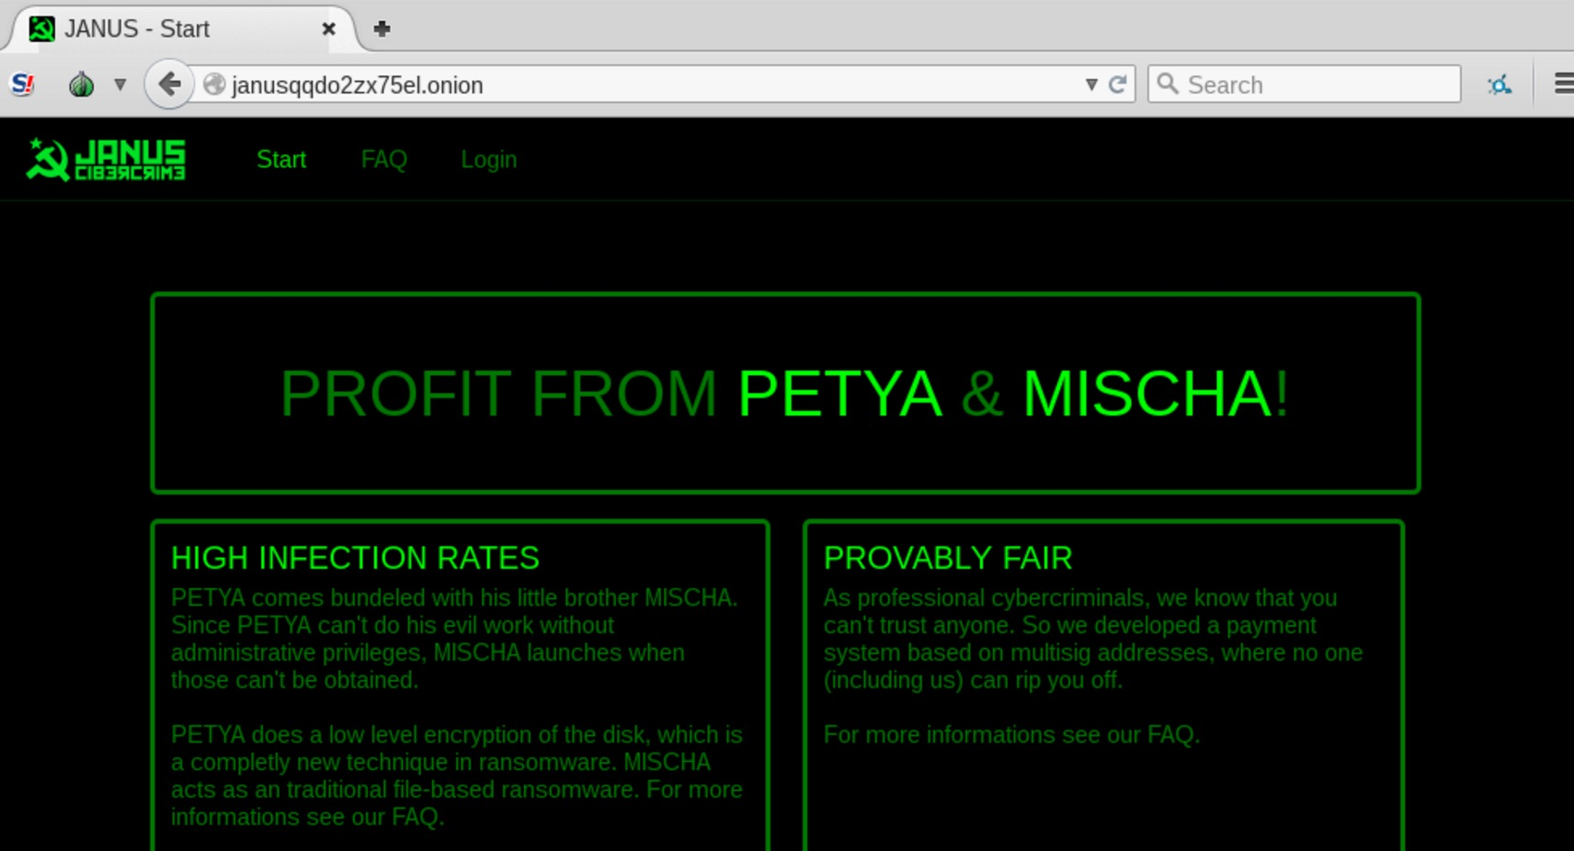
Ransomware as service Underground crime ecosystem

Slide 15
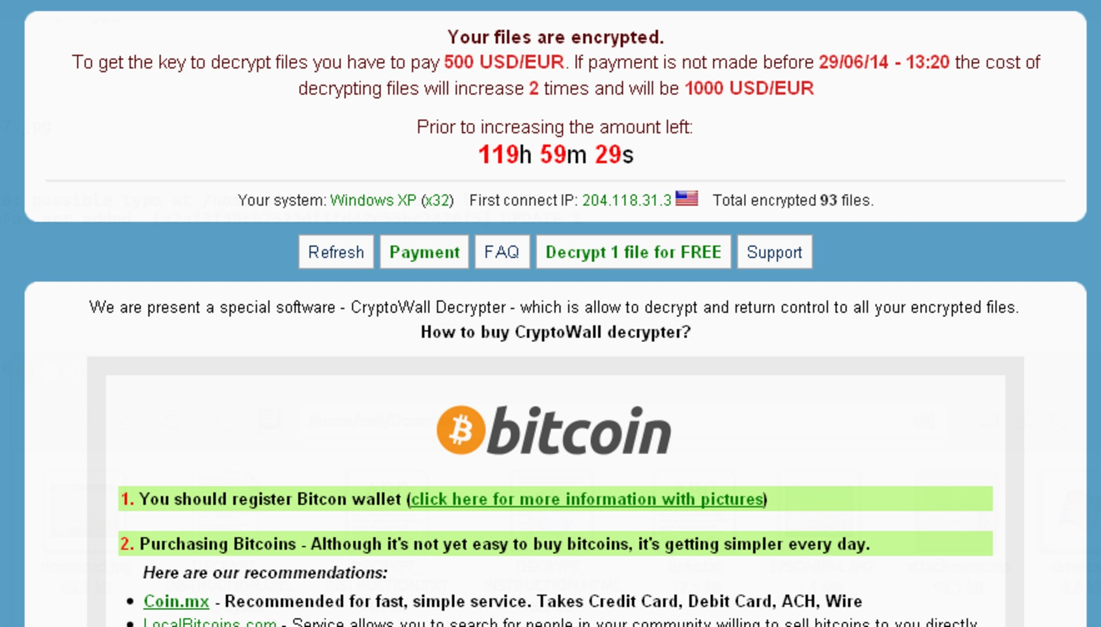
Why Bitcoin?

Slide 16
Why Bitcoin
Provides a level of anonymity in transactions
Acceptance worldwide with relative value higher than mainstream fiat currencies
Bitcoin is not subjected to the controls and regulations of fiat currencies allowing malicious actors to exchange and transfer with practically no oversight from government or international regulatory body.
Bitcoin allows transfers of currency value much higher than using other traditional crime related schemes such as prepaid cards or Moneypak.

Slide 17
TOR
In many ransomware attacks, it is usual to observe instructions to victims on how to access the TOR network for further negotiations.
TOR used as covert channel as well for some C2 and exploitation operations.
The combination of the use of TOR network with covert communications using SSL, makes it even more difficult to detect infected hosts.

Slide 18
Guerrilla Machine Learning for Cybersecurity

Slide 19
Guerrilla Machine Learning for Cybersecurity
Machine Learning in the security problem space should be used very carefully (in some sense it should be looked at like computer driven optimization for a manual security workflow)
Need to be able to “express” the right kind of inputs in easy to use framework

Slide 20
Sequential Behaviors: Exploit Delivery
Initial Redirect From Poisoned Domain: [29/Apr/2015:16:52:23 -0700] "Nico Rosberg" 192.168.122.177 69.162.78.253 1500 200 TCP_HIT "GET http://forbes.com/gels-contrariness-domain-punchable/1.html/548828415920276748 HTTP/1.1" "Internet Services" "low risk" "text/html" 604 142 "Mozilla/4.0 (compatible; MSIE 8.0; Windows NT 6.1; WOW64; Trident/4.0; SLCC2; .NET CLR 2.0.50727; .NET CLR 3.5.30729; .NET CLR 3.0.30729; Media Center PC 6.0)" "http://forbes.com/gels-contrariness-domain-punchable/1.html" "-" "0" "" "-”
Flash Exploit: [29/Apr/2015:16:52:26 -0700] "Nico Rosberg" 192.168.122.177 69.162.78.253 1500 200 TCP_HIT "GET http://portcullisesposturen.europartsplus.org/IMvOBBZKDLqAJYIDe02t5hMMNyzBLN_q4kafJkVNqJVTnTmd HTTP/1.1" "Internet Services" "low risk" "application/x-shockwave-flash" 518 821 "Mozilla/4.0 (compatible; MSIE 8.0; Windows NT 6.1; WOW64; Trident/4.0; SLCC2; .NET CLR 2.0.50727; .NET CLR 3.5.30729; .NET CLR 3.0.30729; Media Center PC 6.0)" "http:///forbes.com/gels-contrariness-domain-punchable/1.html/548828415920276748" "-" "0" "" "-”
Payload: [29/Apr/2015:16:52:27 -0700] "Nico Rosberg" 192.168.122.177 69.162.78.253 1500 200 TCP_HIT "GET http://portcullisesposturen.europartsplus.org/UX7n1YkbNn8FUV6QVtEZLj-p-gLvRKlWEWmz3r7Ug8suRiY_ HTTP/1.1" "Internet Services" "low risk" "application/octet-stream" 136 915 "" "" "-" "0" "" "-”
Command and Control: [29/Apr/2015:16:52:33 -0700] "Nico Rosberg" 192.168.122.177 104.28.28.165 1500 200 TCP_HIT "GET http://dpckd2ftmf7lelsa.jjeyd2u37an30.com/tsdfewr2.php?U3ViamVj49MCZpc182ND0xJmlwPTIxMy4yMjkuODcuMjgmZXhlX3R5cGU9MQ== HTTP/1.1" "Internet Services" "low risk" "text/html; charset=UTF-8" 566 5 "Mozilla/4.0 (compatible; MSIE 8.0; Windows NT 5.1; Trident/4.0; .NET CLR 2.0.50727; .NET CLR 3.0.4506.2152; .NET CLR 3.5.30729)" "" "-" "0" "" "-”
Notes:
Rod

Slide 21
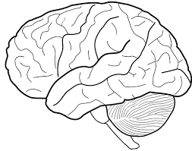
Learning = Compression?
There is a duality between learning and compression
Learning Machine
Primary Key | Time | UserID | Count
Row 1 | … | … | …
Row 2 | … | … | …
Row 3 | … | … | …
… | … | … | …
Row N | … | … | …
C1 | C2 | C3 | C4 | C5
Learned output is a set of “coefficients”
Total Output Size = 1K
Input Data Total Size = 1 GB

Slide 22
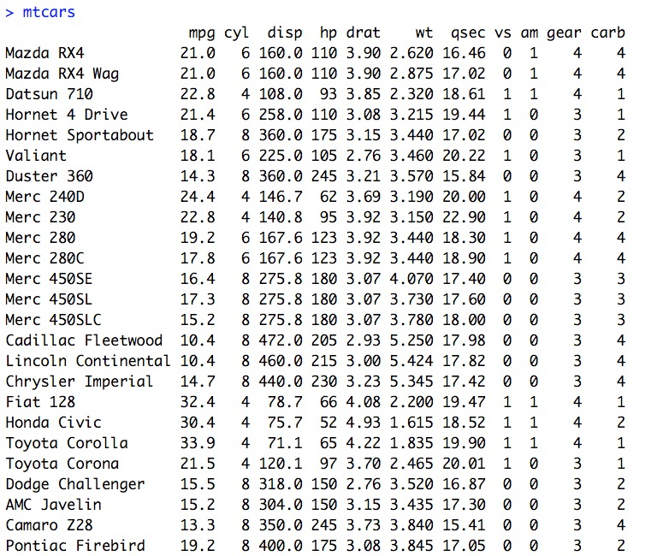
Learning = Compression?
Example of Linear Regression in R
Learning Machine: R Linear Model

Slide 23
Learning = Compression?
Train a model to predict mpg as a function of car weight, number of cylinders and displacement
Learning Machine: R Linear Model

Slide 24
Learning = Compression?
Train a model to predict mpg as a function of car weight, number of cylinders and displacement
Learning Machine: R Linear Model

Slide 25
Learning = Compression?
The overall input data is reduced in a “compressed form” to use in future predictions
Learning Machine: R Linear Model

Slide 26
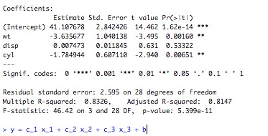
Learning = Compression?
This process is extremely brittle in terms of modeling a changing signal or an adversary that changes patterns over time
Learning Machine: R Linear Model

Slide 27
Learning = Compression?
The simple linear model gives us output that separates the Signal from the Noise (this is not always possible with a model)
Learning Machine: R Linear Model

Slide 28
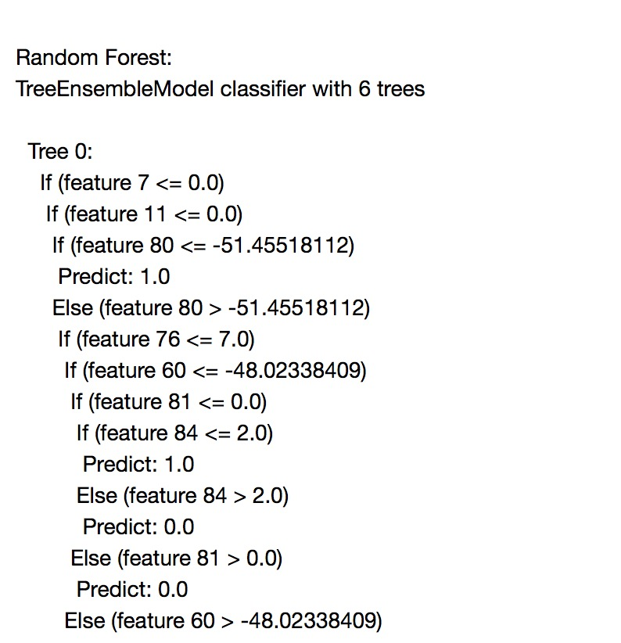
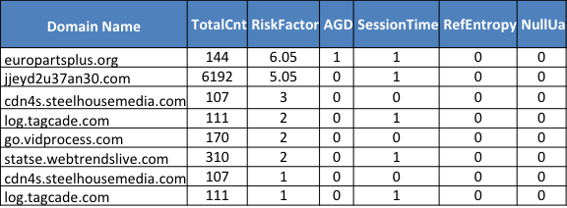
Learning = Compression?
Real example of random forest trained on C2 traffic
Learning Machine: MLLib Random Forest

Slide 29
Learning = Compression?
We really “learn” a function we can call in batch or real time

Slide 30
Key to ML: Label Your Analysis
Label output of every investigation in a consistent manner!!!
Domain Name | TotalCnt | RiskFactor | AGD | SessionTime | RefEntropy | NullUa
europartsplus.org | 144 | 6.05 | 1 | 1 | 0 | 0
jjeyd2u37an30.com | 6192 | 5.05 | 0 | 1 | 0 | 0
cdn4s.steelhousemedia.com | 107 | 3 | 0 | 0 | 0 | 0
log.tagcade.com | 111 | 2 | 0 | 1 | 0 | 0
go.vidprocess.com | 170 | 2 | 0 | 0 | 0 | 0
statse.webtrendslive.com | 310 | 2 | 0 | 1 | 0 | 0
cdn4s.steelhousemedia.com | 107 | 1 | 0 | 0 | 0 | 0
log.tagcade.com | 111 | 1 | 0 | 1 | 0 | 0

Slide 31
Key to ML: Label Your Analysis
This is how the algorithms will “learn” from human expertise and help support a common security workflow
Domain Name | TotalCnt | RiskFactor | AGD | SessionTime | RefEntropy | NullUa | Outcome
yyfaimjmocdu.com | 144 | 6.05 | 1 | 1 | 0 | 0 | Malicious
jjeyd2u37an30.com | 6192 | 5.05 | 0 | 1 | 0 | 0 | Malicious
cdn4s.steelhousemedia.com | 107 | 3 | 0 | 0 | 0 | 0 | Benign
log.tagcade.com | 111 | 2 | 0 | 1 | 0 | 0 | Benign
go.vidprocess.com | 170 | 2 | 0 | 0 | 0 | 0 | Benign
statse.webtrendslive.com | 310 | 2 | 0 | 1 | 0 | 0 | Benign
cdn4s.steelhousemedia.com | 107 | 1 | 0 | 0 | 0 | 0 | Benign
log.tagcade.com | 111 | 1 | 0 | 1 | 0 | 0 | Benign
Human Expertise is manually encoded into a format computers understand: Sometimes this process is called Labeling or “Truth-ing” the data

Slide 32
Modeling Ransomware Behaviors

Slide 33
Ransomware Delivery and The Modern Threat Surface
Stages of A Typical Enterprise Campaign
Phishing Campaign/Watering Hole Established
Exploitation (Focus Of Aktaion)
File System Modification (Too Late – Much Of Current Research Focuses Here)
Ransom Note (DNS IPS Monitoring Can be Helpful Here)

Slide 34
Post Exploit Resources/Research
CryptoLock (and Drop It): Stopping Ransomware Attacks on User Data
http://www.cise.ufl.edu/~traynor/papers/scaife-icdcs16.pdf
Ransomware Overview
This initial list has been composed by Mosh @nyxbone and transformed into this Google Docs format by @cyb3rops (Ransomware Overview is licensed under a Creative Commons Attribution-NonCommercial-ShareAlike 4.0 International License.)
https://docs.google.com/spreadsheets/d/1TWS238xacAto-fLKh1n5uTsdijWdCEsGIM0Y0Hvmc5g/pubhtml
Something Called Cryptowall prevention kit (now is pay to play it seems)

Slide 35
Exploit Research
Detecting malicious HTTP redirections using trees of user browsing activity, Hesham Mekky et. Al.
“…We build per-user chains from passively collected traffic and extract novel statistical features from them, which capture inherent characteristics from malicious redirection cases. Then, we apply a supervised decision tree classifier to identify malicious chains. Using a large ISP dataset, with more than 15K clients, we demonstrate that our methodology is very effective in accurately identifying malicious chains, with recall and precision values over 90% and up to 98%”
IEEE INFOCOM 2014 - IEEE Conference on Computer Communications

Slide 36
Exploit Data
386 Labeled Exploit chain examples from Contagio (PCAP extracts into a generic proxy format)
CRIMEb from DeepEnd Research (DeepEnd Research)
https://www.dropbox.com/sh/7fo4efxhpenexqp/AADHnRKtL6qdzCdRlPmJpS8Aa/CRIME?dl=0

Slide 37
Plan of Attack
Ransomware Behaviors:
File system Specific
Call Back Specific
Exploit Kits
Command and Control behavior can vary widely depending on the post exploit agenda
Sweet Spot: Exploit Delivery

Slide 38
ML For Security = Labeled Malicious or Benign Events
Samples located at
https://github.com/jzadeh/aktaion2/data
https://github.com/jzadeh/aktaion/data (deprecated version)
Ransomware Samples
Small amount of mixed call back/file system level indicators
Exploit Samples
348 PCAPs converted to a Proxy Format
Thanks to the hard work of Contagio and Mila Parkour http://contagiodump.blogspot.com/
Benign Bro Traffic Samples
Multiple independent user sessions

Slide 39
Expressing Microbehaviors in Code: Aktaion V2
https://github.com/jzadeh/aktaion2/tree/blackhat_eu_2017 (careful not merged into master until EOW for now use the following for access)
git clone https://github.com/jzadeh/aktaion2.git
git checkout origin blackhat_eu_2017
Migrated Core Logic and Modules to Python3 Implementation
aktaion2/python
./run_ml.sh : builds machine learning ready data sets given input directories and window sizes and config parameters
./run_aktaion2.sh : use to reproduce what you see in the arsenal demo and score individual files
aktaion2/python/research_dev/random_forest:
micro_beahvior_core_logic.py : key abstraction used for building important characteristics about attack/benign in a form useful for AI to learn from
rf_v2.py, svm.py, calibration.py : main machine learning based tools using Random Forest, Support Vector Machine and Classifier performance analysis

Slide 40
Workflow
Take PCAPs of known (labeled) exploits and known (labeled) benign behavior and convert them to bro format
Convert each Bro log to a sequence of micro behaviors (machine learning input)
Compare the sequence of micro behaviors to a set of known benign/malicious samples using a Random Forest Classifier (http://weka.sourceforge.net/doc.dev/weka/classifiers/trees/RandomForest.html)
Derive a list of indicators from any log predicted as malicious
Pass the list of IOCs (JSON) to a GPO generation script (https://github.com/jzadeh/Aktaion/tree/master/python)

Slide 41
Aktaion Logical Workflow
conn.log
Bro –r traffic.pcap
http.log
traffic.pcap
ssl.log
files.log

Slide 42
Aktaion Logical Workflow
AKTAION Core
conn.log
AD_IP | Mime Type
10.10.50.25 | text/html
10.10.50.25 | text/html
93.190.48.4 | text/html
195.3.124.165 | application/octect-stream
176.9.159.141 | application/x-shockwave-flash"
192.168.1.65 | application/x-shockwave-flash
10.13.11.221
192.168.1.65 | text/html
Micro Behaviors Over Window 1
Bro –r traffic.pcap
http.log
traffic.pcap
ssl.log
Micro Behaviors Over Window 2
files.log
Output: Sequence(MB1, MB2, MB3 …)

Slide 43
Aktaion Logical Workflow
AKTAION Core
conn.log
AD_IP | Mime Type
10.10.50.25 | text/html
10.10.50.25 | text/html
93.190.48.4 | text/html
195.3.124.165 | application/octect-stream
176.9.159.141 | application/x-shockwave-flash"
192.168.1.65 | application/x-shockwave-flash
10.13.11.221
192.168.1.65 | text/html
Micro Behaviors Over Window 1
Bro –r traffic.pcap
http.log
traffic.pcap
ssl.log
Micro Behaviors Over Window 2
files.log
Output: Sequence(MB1, MB2, MB3 …)
Active Defense: Automated GPO Generation
Machine Learning Logic: Random Forest
IOCs Observed
Exploit Delivery Examples
Benign Traffic Examples
ActiveDefense.py –n ‘IOCs’

Slide 44
Finding the Initial Exploit
Initial Redirect From Poisoned Domain: [29/Apr/2015:16:52:23 -0700] "Nico Rosberg" 192.168.122.177 69.162.78.253 1500 200 TCP_HIT "GET http://forbes.com/gels-contrariness-domain-punchable/1.html/548828415920276748 HTTP/1.1" "Internet Services" "low risk" "text/html" 604 142 "Mozilla/4.0 (compatible; MSIE 8.0; Windows NT 6.1; WOW64; Trident/4.0; SLCC2; .NET CLR 2.0.50727; .NET CLR 3.5.30729; .NET CLR 3.0.30729; Media Center PC 6.0)" "http://forbes.com/gels-contrariness-domain-punchable/1.html" "-" "0" "" "-”
Notes:
Rod

Slide 45
Finding the Initial Exploit
Initial Redirect From Poisoned Domain: [29/Apr/2015:16:52:23 -0700] "Nico Rosberg" 192.168.122.177 69.162.78.253 1500 200 TCP_HIT ”GET http://forbes.com/gels-contrariness-domain-punchable/1.html/548828415920276748 HTTP/1.1" "Internet Services" "low risk" "text/html" 604 142 "Mozilla/4.0 (compatible; MSIE 8.0; Windows NT 6.1; WOW64; Trident/4.0; SLCC2; .NET CLR 2.0.50727; .NET CLR 3.5.30729; .NET CLR 3.0.30729; Media Center PC 6.0)" "http://forbes.com/gels-contrariness-domain-punchable/1.html" "-" "0" "" "-”
Flash Exploit: [29/Apr/2015:16:52:26 -0700] "Nico Rosberg" 192.168.122.177 69.162.78.253 1500 200 TCP_HIT "GET http://portcullisesposturen.europartsplus.org/IMvOBBZKDLqAJYIDe02t5hMMNyzBLN_q4kafJkVNqJVTnTmd HTTP/1.1" "Internet Services" "low risk" "application/x-shockwave-flash" 518 821 "Mozilla/4.0 (compatible; MSIE 8.0; Windows NT 6.1; WOW64; Trident/4.0; SLCC2; .NET CLR 2.0.50727; .NET CLR 3.5.30729; .NET CLR 3.0.30729; Media Center PC 6.0)" "http:///forbes.com/gels-contrariness-domain-punchable/1.html/548828415920276748" "-" "0" "" "-”
Notes:
Rod

Slide 46
Finding the Initial Exploit
Initial Redirect From Poisoned Domain: [29/Apr/2015:16:52:23 -0700] "Nico Rosberg" 192.168.122.177 69.162.78.253 1500 200 TCP_HIT "GET http://forbes.com/gels-contrariness-domain-punchable/1.html/548828415920276748 HTTP/1.1" "Internet Services" "low risk" "text/html" 604 142 "Mozilla/4.0 (compatible; MSIE 8.0; Windows NT 6.1; WOW64; Trident/4.0; SLCC2; .NET CLR 2.0.50727; .NET CLR 3.5.30729; .NET CLR 3.0.30729; Media Center PC 6.0)" "http://forbes.com/gels-contrariness-domain-punchable/1.html" "-" "0" "" "-”
Flash Exploit: [29/Apr/2015:16:52:26 -0700] "Nico Rosberg" 192.168.122.177 69.162.78.253 1500 200 TCP_HIT "GET http://portcullisesposturen.europartsplus.org/IMvOBBZKDLqAJYIDe02t5hMMNyzBLN_q4kafJkVNqJVTnTmd HTTP/1.1" "Internet Services" "low risk" "application/x-shockwave-flash" 518 821 "Mozilla/4.0 (compatible; MSIE 8.0; Windows NT 6.1; WOW64; Trident/4.0; SLCC2; .NET CLR 2.0.50727; .NET CLR 3.5.30729; .NET CLR 3.0.30729; Media Center PC 6.0)" "http:///forbes.com/gels-contrariness-domain-punchable/1.html/548828415920276748" "-" "0" "" "-”
Payload: [29/Apr/2015:16:52:27 -0700] "Nico Rosberg" 192.168.122.177 69.162.78.253 1500 200 TCP_HIT "GET http://portcullisesposturen.europartsplus.org/UX7n1YkbNn8FUV6QVtEZLj-p-gLvRKlWEWmz3r7Ug8suRiY_ HTTP/1.1" "Internet Services" "low risk" "application/octet-stream" 136 915 "" "" "-" "0" "" "-”
Notes:
Rod

Slide 47
Finding the Initial Exploit
Initial Redirect From Poisoned Domain: [29/Apr/2015:16:52:23 -0700] "Nico Rosberg" 192.168.122.177 69.162.78.253 1500 200 TCP_HIT "GET http://forbes.com/gels-contrariness-domain-punchable/1.html/548828415920276748 HTTP/1.1" "Internet Services" "low risk" "text/html" 604 142 "Mozilla/4.0 (compatible; MSIE 8.0; Windows NT 6.1; WOW64; Trident/4.0; SLCC2; .NET CLR 2.0.50727; .NET CLR 3.5.30729; .NET CLR 3.0.30729; Media Center PC 6.0)" "http://forbes.com/gels-contrariness-domain-punchable/1.html" "-" "0" "" "-”
Flash Exploit: [29/Apr/2015:16:52:26 -0700] "Nico Rosberg" 192.168.122.177 69.162.78.253 1500 200 TCP_HIT "GET http://portcullisesposturen.europartsplus.org/IMvOBBZKDLqAJYIDe02t5hMMNyzBLN_q4kafJkVNqJVTnTmd HTTP/1.1" "Internet Services" "low risk" "application/x-shockwave-flash" 518 821 "Mozilla/4.0 (compatible; MSIE 8.0; Windows NT 6.1; WOW64; Trident/4.0; SLCC2; .NET CLR 2.0.50727; .NET CLR 3.5.30729; .NET CLR 3.0.30729; Media Center PC 6.0)" "http:///forbes.com/gels-contrariness-domain-punchable/1.html/548828415920276748" "-" "0" "" "-”
Payload: [29/Apr/2015:16:52:27 -0700] "Nico Rosberg" 192.168.122.177 69.162.78.253 1500 200 TCP_HIT "GET http://portcullisesposturen.europartsplus.org/UX7n1YkbNn8FUV6QVtEZLj-p-gLvRKlWEWmz3r7Ug8suRiY_ HTTP/1.1" "Internet Services" "low risk" "application/octet-stream" 136 915 "" "" "-" "0" "" "-”
Command and Control: [29/Apr/2015:16:52:33 -0700] "Nico Rosberg" 192.168.122.177 104.28.28.165 1500 200 TCP_HIT "GET http://dpckd2ftmf7lelsa.jjeyd2u37an30.com/tsdfewr2.php?U3ViamVj49MCZpc182ND0xJmlwPTIxMy4yMjkuODcuMjgmZXhlX3R5cGU9MQ== HTTP/1.1" "Internet Services" "low risk" "text/html; charset=UTF-8" 566 5 "Mozilla/4.0 (compatible; MSIE 8.0; Windows NT 5.1; Trident/4.0; .NET CLR 2.0.50727; .NET CLR 3.0.4506.2152; .NET CLR 3.5.30729)" "" "-" "0" "" "-”
Notes:
Rod

Slide 48
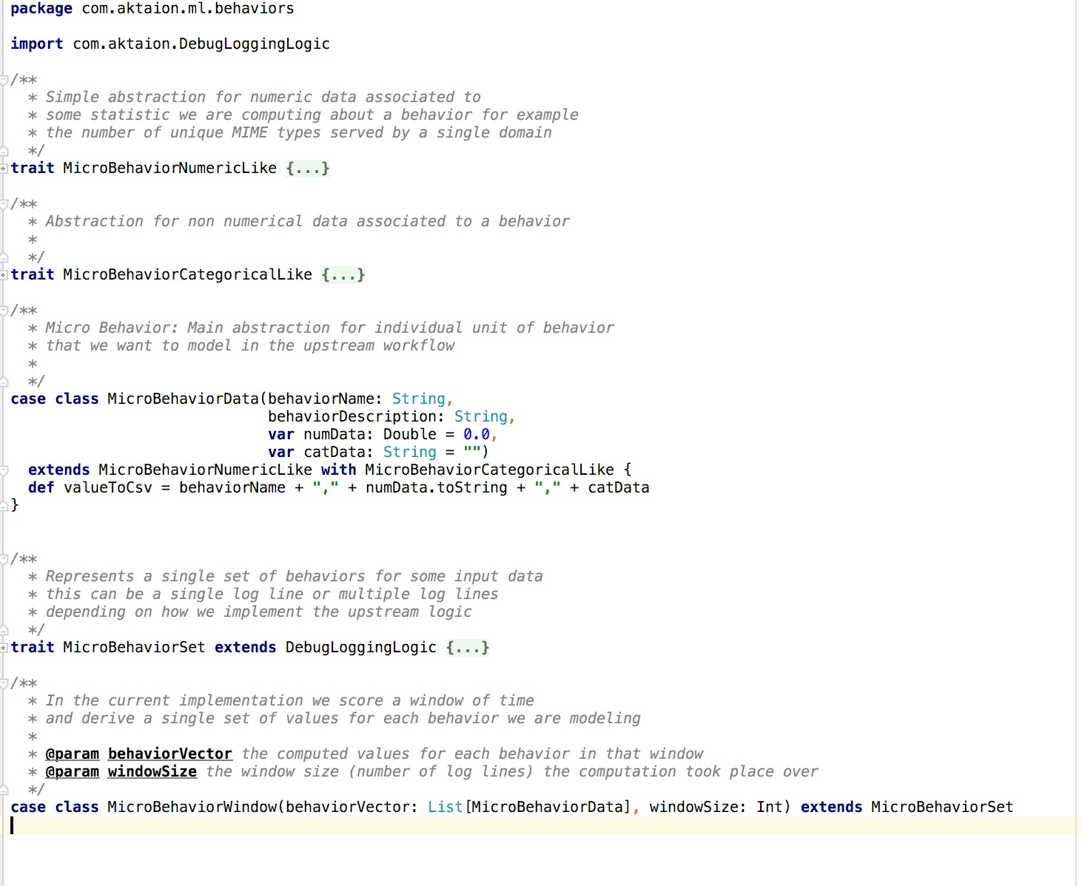
Expressing Microbehaviors in Code: Aktaion V1

Slide 49
Expressing Microbehaviors in Code
TTP = Microbehavior
We want a flexible enough framework for blending both signatures on a pattern match with more general observations like
‘Interesting’ sequences of Mime types of length < 5
Referrer Sequences with Small inter-arrival times
Mime type distribution in a time window across a single source IP
Comparison of probability of observed (MIME Type, Extension) to overall enterprise population: example (octect-stream, .mp3) is extremely rare

Slide 50
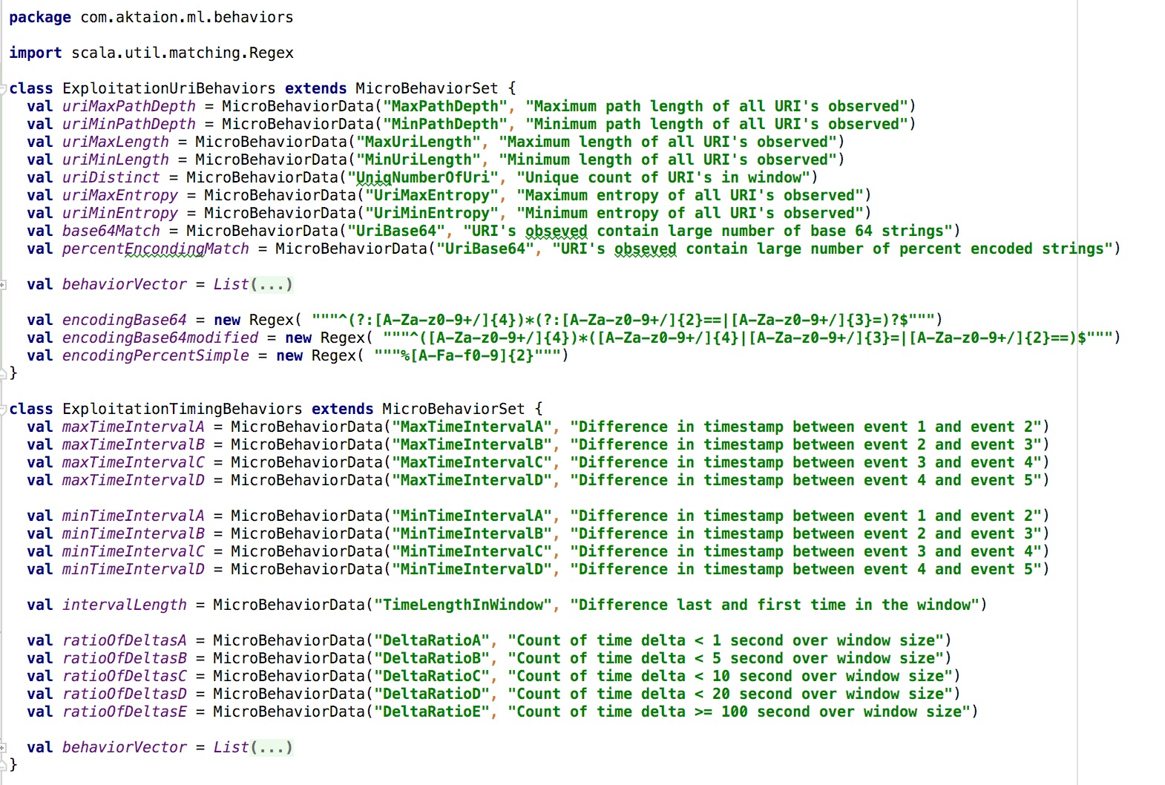
Expressing Microbehaviors in Code: Aktaion V1

Slide 51
Expressing Microbehaviors in Code: Aktaion V2
https://github.com/jzadeh/aktaion2/tree/blackhat_eu_2017 (careful not merged into master until EOW for now use the following for access
git clone https://github.com/jzadeh/aktaion2.git
git checkout origin blackhat_eu_2017
Migrated Core Logic and Modules to Python3 Implementation
aktaion2/python
./run_ml.sh : builds machine learning ready data sets given input directories and window sizes and config parameters
./run_aktaion2.sh : use to reproduce what you see in the arsenal demo and score individual files
Aktaion2/python/research_dev/random_forest:
Micro_beahvior_core_logic.py : key abstraction used for building important characteristics about attack/benign in a form useful for AI to learn from
Rf_v2.py, svm.py, calibration.py : main machine learning based tools using Random Forest, Support Vector Machine and Classifier performance analysis

Slide 52
Expressing Microbehaviors in Code: Aktaion V2
Additional Functionality
aktaion2/data : location of all data sets including proxy, bro, Palo Alto and raw PCAP examples. Sample files prepped for machine learning are located in logs_normalized_format
aktaion2/documentation : AKTAIONv2BHEU2017.pptx and other docs available from related ML + Cyber open source projects

Slide 53
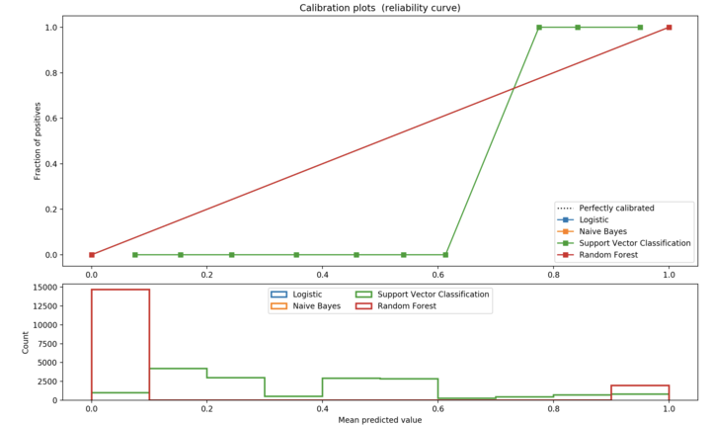
Classifier Trained On Raw Exploit/Benign HTTP Samples

Slide 54
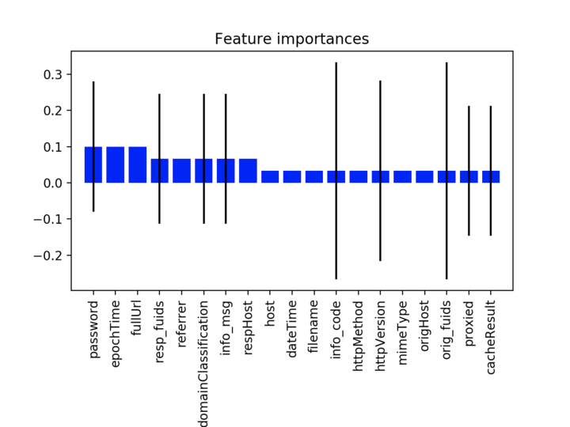
Classifier Trained On Raw Exploit/Benign HTTP Samples: Random Forest Variable Importance Plot

Slide 55
Ranking the best ML
Nearest Neighbors 0.925
Linear SVM 0.4
RBF SVM 0.875
Gaussian Process 0.9
Decision Tree 0.775
Random Forest 0.825
Neural Net 0.775
AdaBoost 0.825
Naive Bayes 0.7
QDA 0.725

Slide 56
TTPs and Machine Learning
David Bianco http://detect-respond.blogspot.com/2013/03/the-pyramid-of-pain.html
Pyramid of Pain Paraphrase “1st level IOC’s can be modified easily by an adversary (IP address, File Hash) whereas higher level TTPs (Techniques, Tactics, Procedure) are expressions of an adversaries behavior at a higher level and are harder for the adversary to modify (the attackers training to use a specific tool, exfil sequence etc..)
TTP We Focus on Primarily: Initial Exploit Delivery
We use this idea to reduce the problem of detecting Ransomware in the environment to an early stage in the life cycle of the attacker
Lots of re

Slide 57
More Micro Behavior Mining
Payload delivery. Focused on traffic to malicious sites and the related indicators when malicious code is served. Including things such as URI entropy, redirects, domain generated by algorithms (DGAs), types and sequences of MIME content presented to victim during payload delivery. A reputation feed from ransomware domains and IP was used as ground truth (http://ransomwaretracker.abuse.ch/), as well as PCAP samples from sites such as http://www.malware-traffic-analysis.net/ , http://contagiodump.blogspot.com/ , and data collected during field research.
Call backs (Phone home) patterns, including user agent , URI strings, HTTP “GET” or “POST” requests, DNS queries, URI strings, frequency of call backs, periodicity of connections.
Covert Channel indicators, such as non HTTP traffic (HTTPS), and non DNS traffic present during such communications.

Slide 58
Key Micro Behaviors
Mime Type Sequences Occurring in a Single Sequence of Small Time length from a Single Host

Slide 59
Scaling the approach to other problems

Slide 60
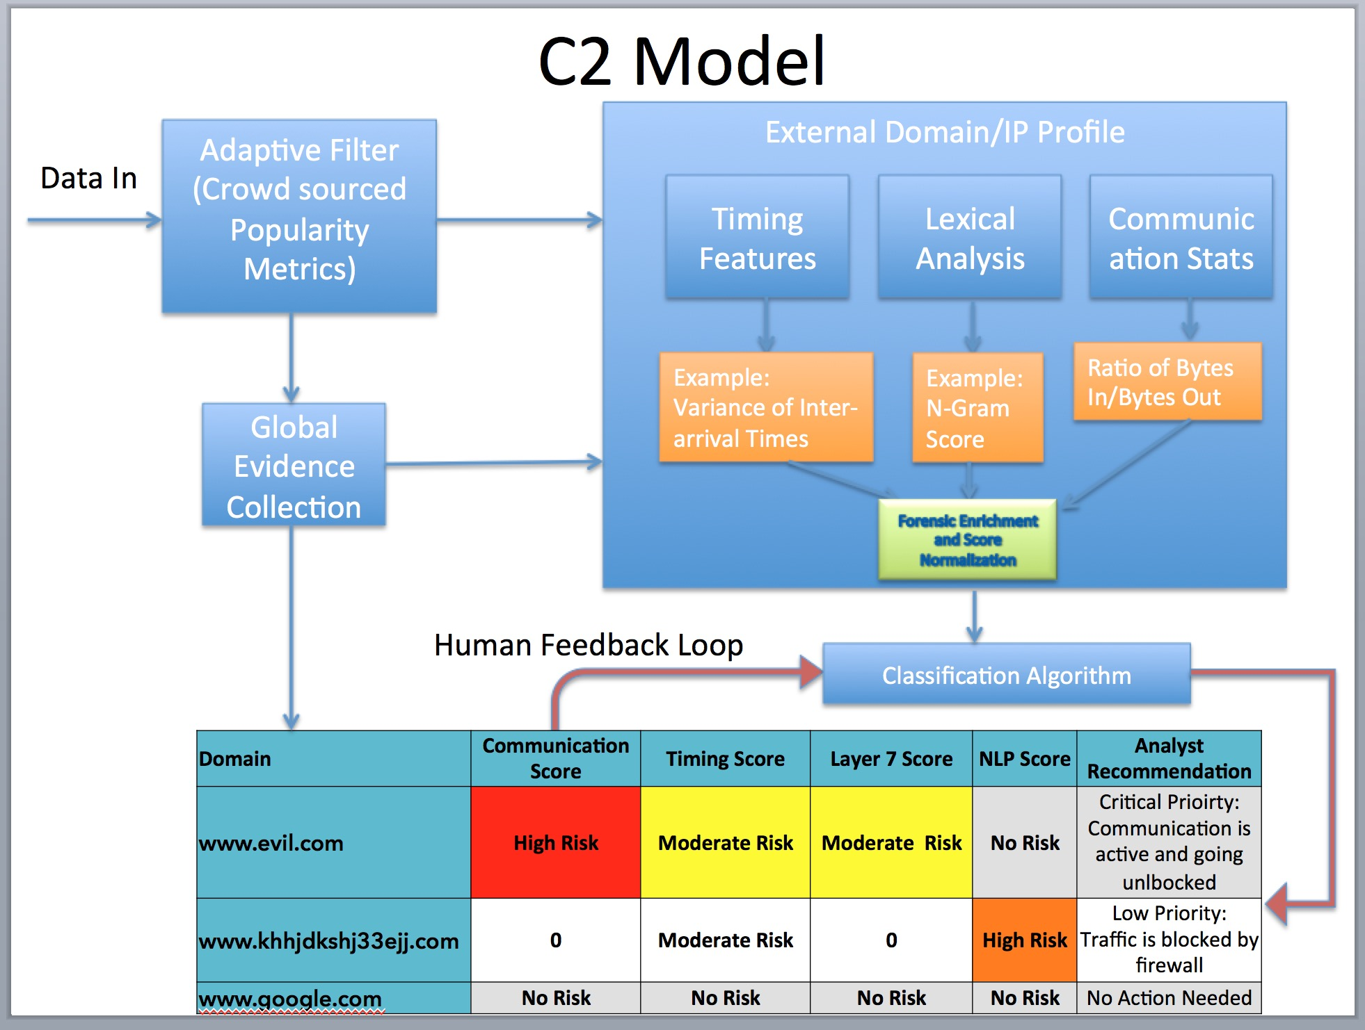





ML + Sequencing the Security DNA
We parallelize across many nodes (JVMs) and use both real time and batch computations
JVM 1
GET http://forbes.com/gels-contrariness-domain-punchable/"
GET http://portcullisesposturen.europartsplus.org/
POST http://dpckd2ftmf7lelsa.jjeyd2u37an30.com/
JVM 2
GET http://youtube.com/
GET http://avazudsp.net/
GET http://betradar.com/
GET http://displaymarketplace.com/
JVM 3
GET http:/clickable.net/
GET http://vuiviet.vn/
GET http://homedepotemail.com/
GET http://css-tricks.com/

Slide 61
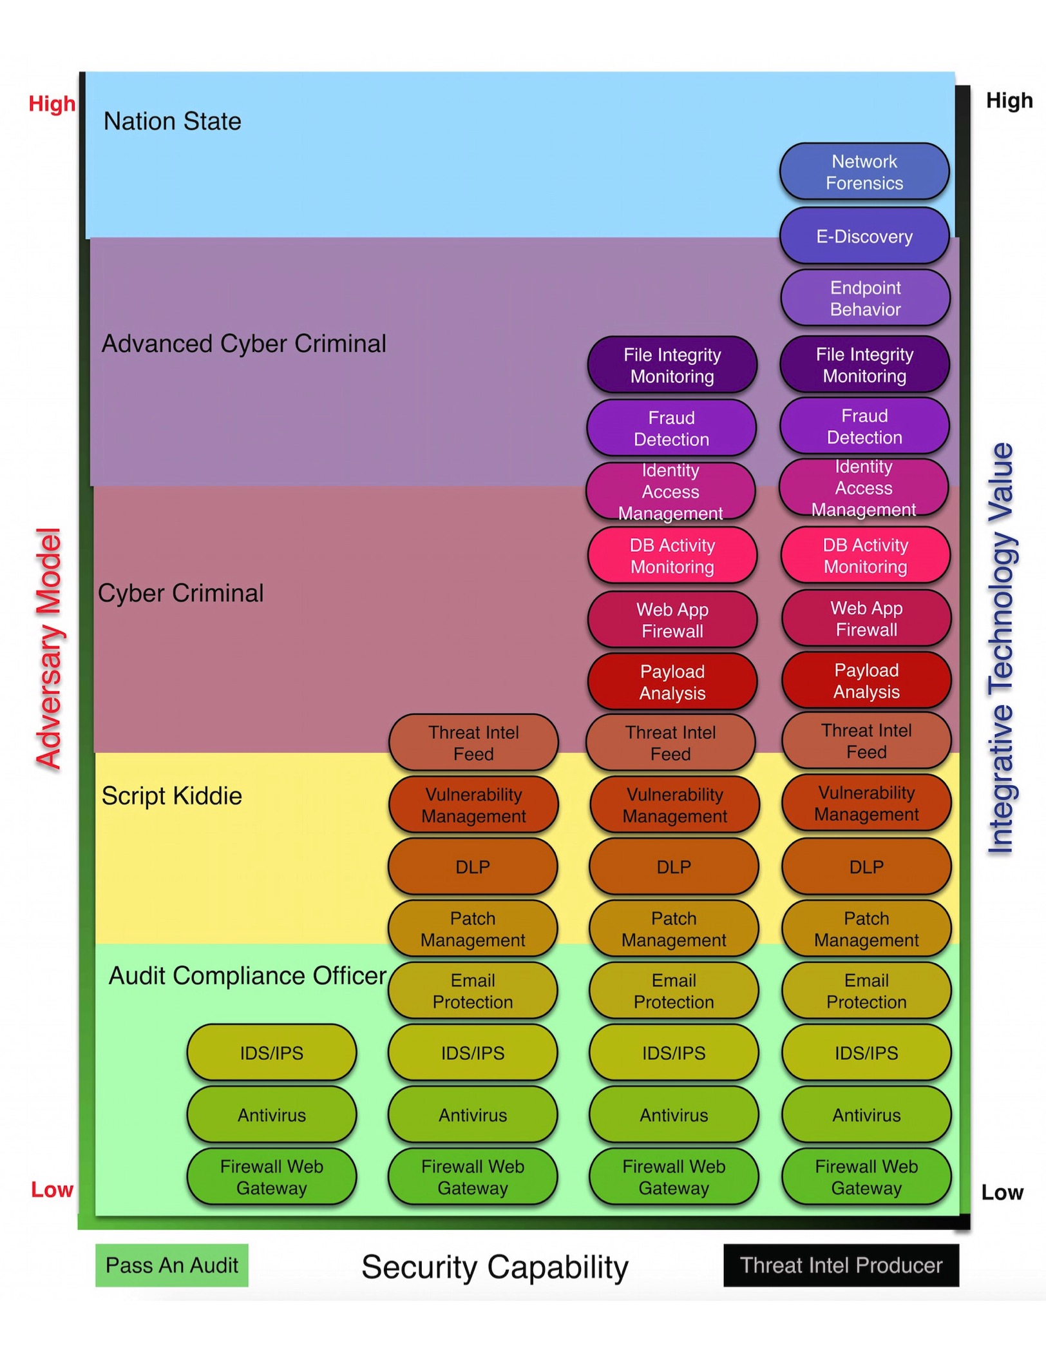
Adversarial Models
Machine Learning Looses Effectiveness the more complex the adversary

Slide 62

Adversarial Models
Non-Automatable Actions: Hybrid Human/Computer Analysis
Automatable Actions: Good for ML

Slide 63
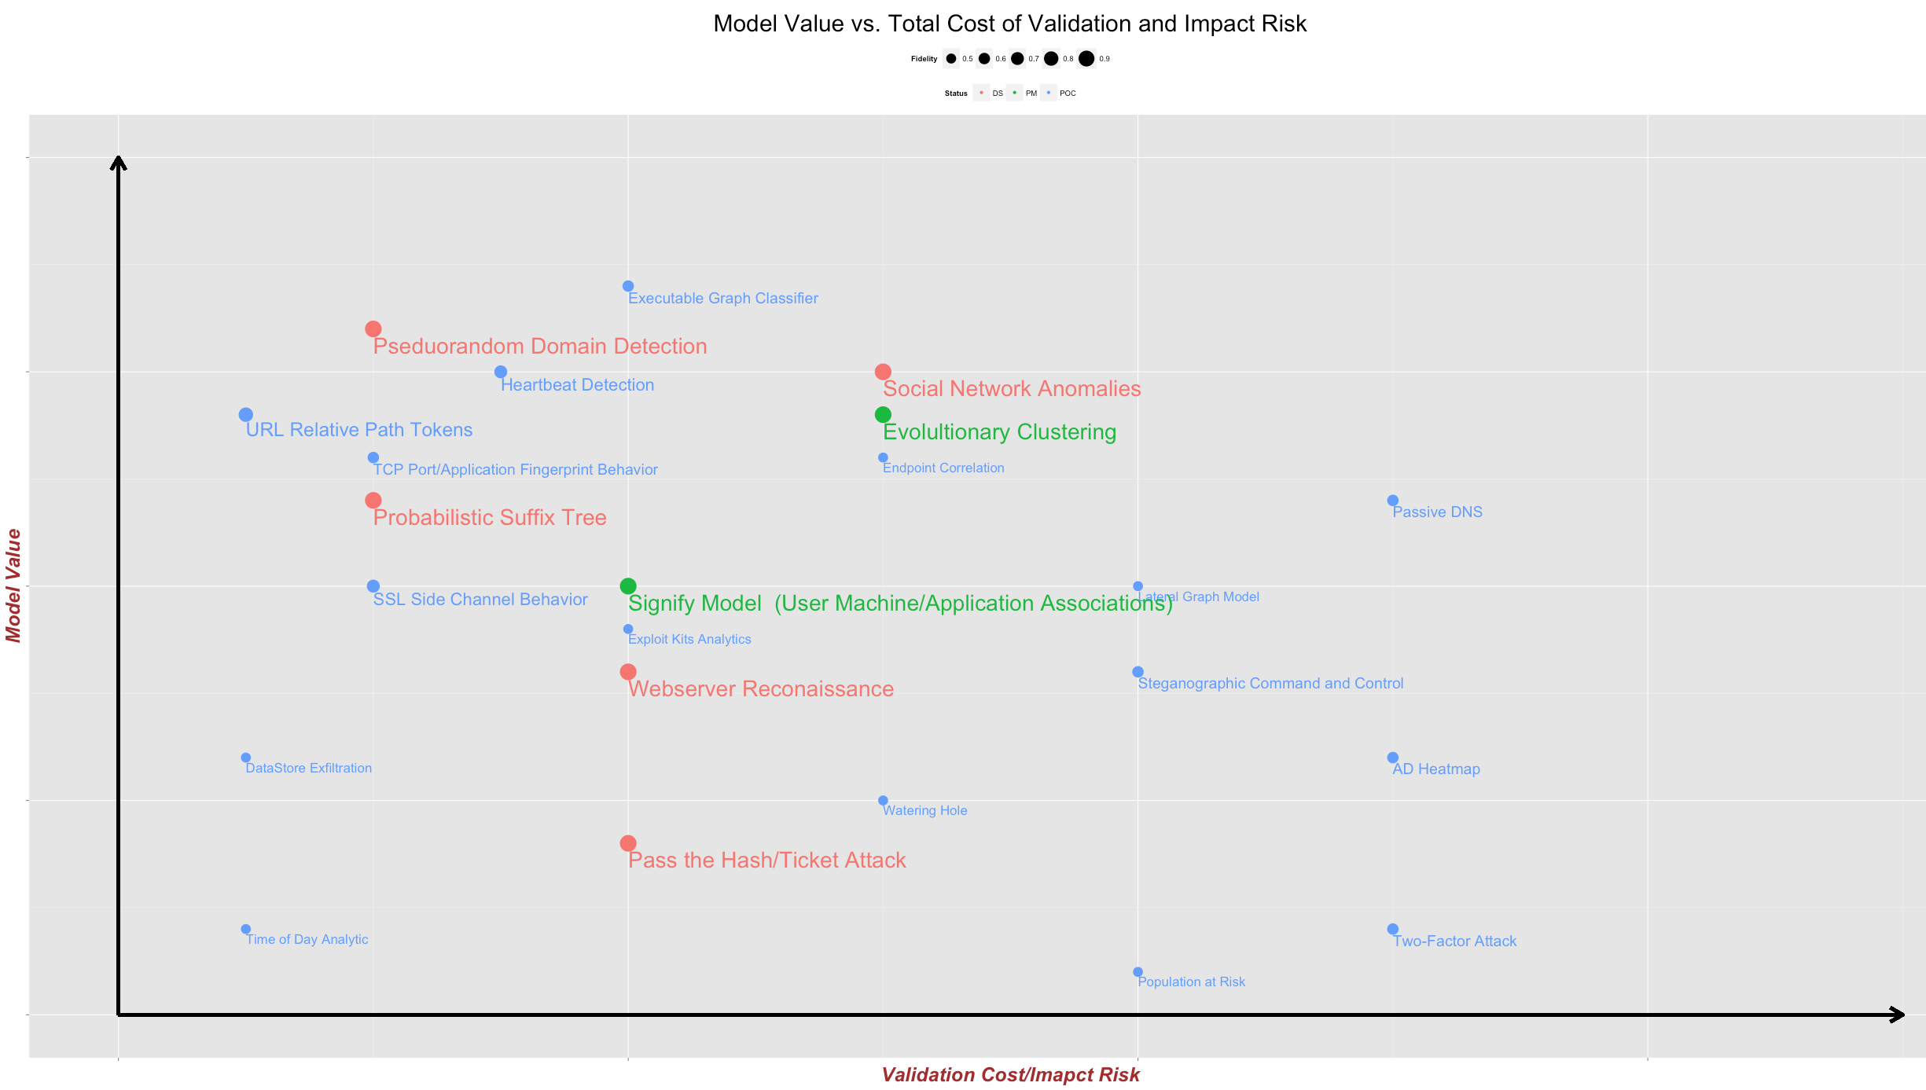
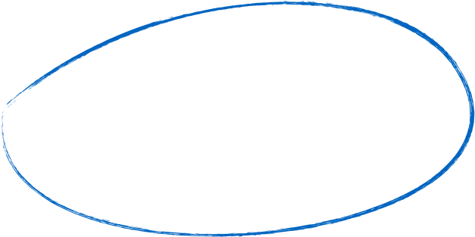
Cybersecurity Analytics: ROIv1
WAN
LAN

Slide 64



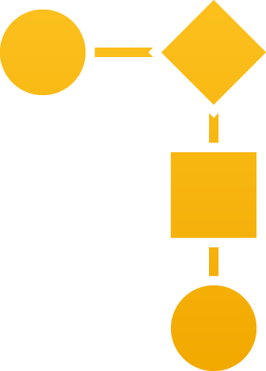

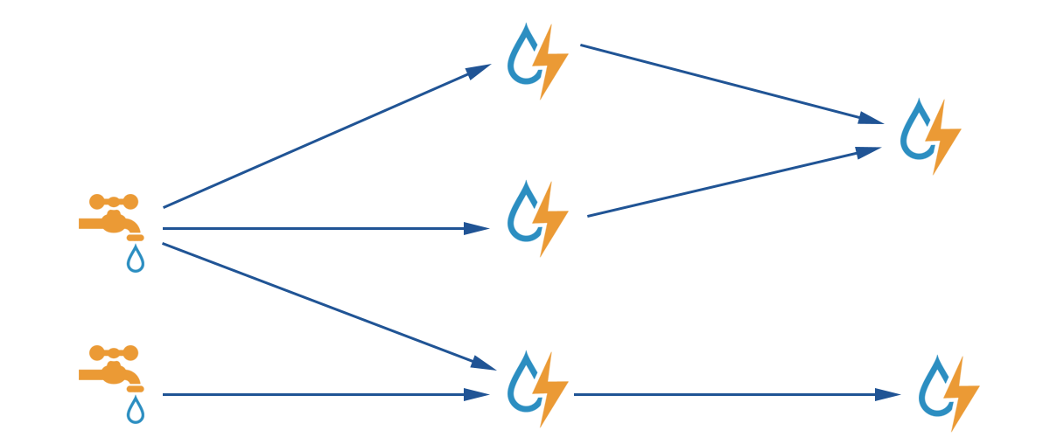

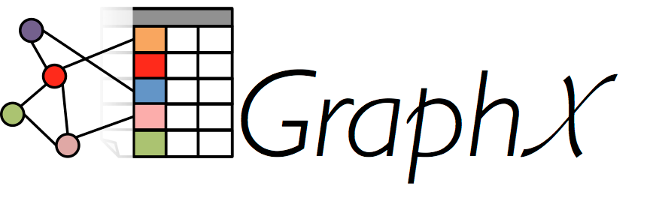


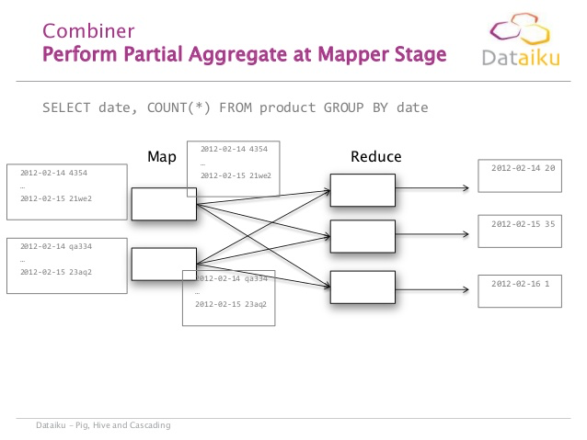
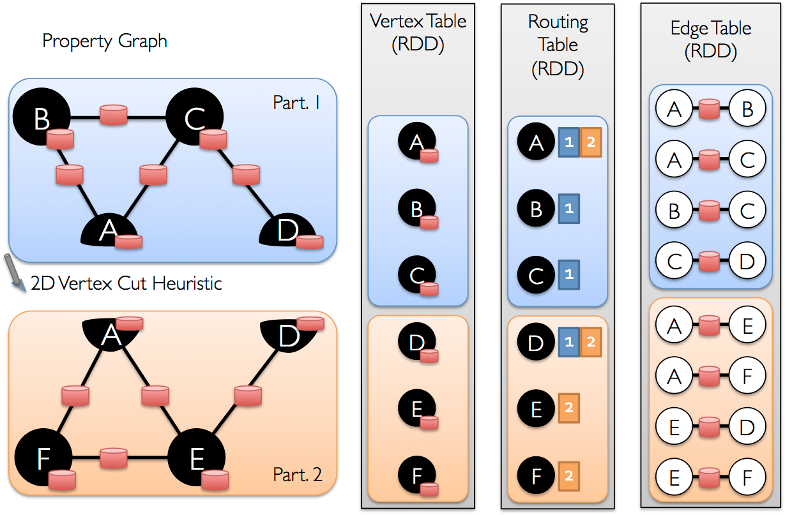
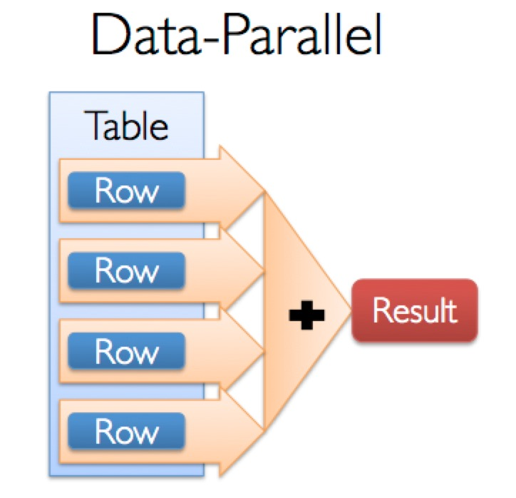

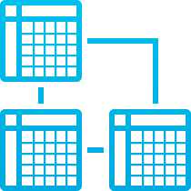

Lambda Security
Real Time Layer
DHCP
Real Time Identity Resolution
Sequential Models and IOC’s
IP | DHCP.MAC | DHCP_Lasteventtime | AD_FQDN
10.100.1.23 | 58:5c:35:c3:6e:a4 | 2014-03-11T14:00:00 | joe.eng.acme.com
10.13.11.221 | 12:3a:74:b2:6a:22 | 2014-03-12T14:30:00 | ad.hr.acme.com
IMS/IPAM
Hybrid View (Batch + Real Time)
AD
Username = select coallesce(user_name, hostname, IP) from Active_ID_Table where IP = ‘10.10.100.23)
FW
Distributed ETL
VPN
Proxy
Data Ingest
Large Scale Models and Non-Sequential IOC’s
Batch Layer

Slide 65
ML + Sequencing the Security DNA
We parallelize across many nodes (JVMs) and use both real time and batch computations
JVM 1
GET http://forbes.com/gels-contrariness-domain-punchable/"
GET http://portcullisesposturen.europartsplus.org/
POST http://dpckd2ftmf7lelsa.jjeyd2u37an30.com/
JVM 2
GET http://youtube.com/
GET http://avazudsp.net/
GET http://betradar.com/
GET http://displaymarketplace.com/
JVM 3
GET http:/clickable.net/
GET http://vuiviet.vn/
GET http://homedepotemail.com/
GET http://css-tricks.com/

Slide 66
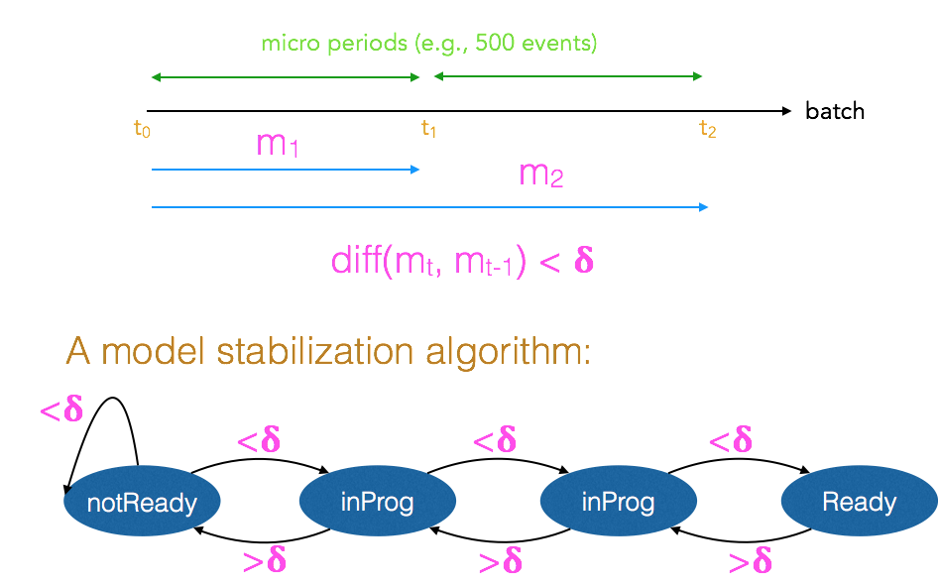
When is a model ready?

Slide 67
The Tool - Aktaion
Based on Java
Github: https://github.com/jzadeh/Aktaion
- Developed using Apache Spark notebookhttps://github.com/andypetrella/spark-notebook
Leverages the use of Apache Spark an open source distributed computing framework which allows scalable data processing
Uses Apache Spark MLLib machine learning library for analytics.

Slide 68
The Tool - Aktaion
Processes input from PCAPs, BRO, proxies & firewall logs.
Mines and displays relationships of Micro behaviors particular to ransomware traffic.
Produces two results
- Risk core based on algorithm learning
- Feature vector from analysis
*Output in .JSON for further use and interoperability with other tools or technologies.

Slide 69
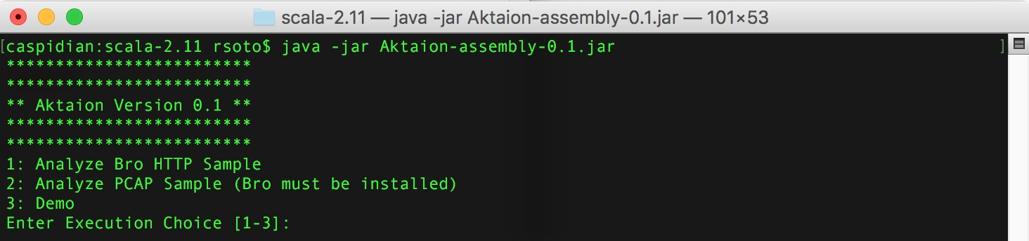
POC
The Tool

Slide 70
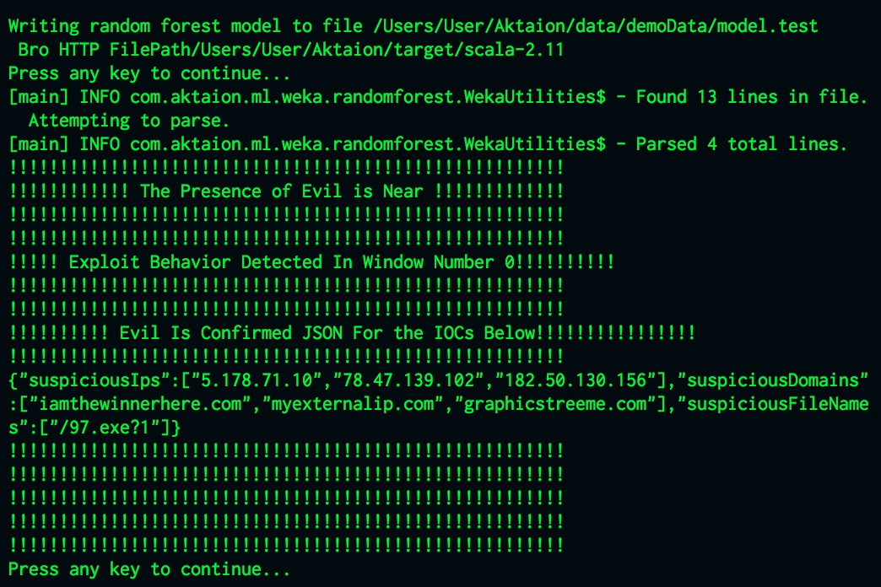
Results

Slide 71
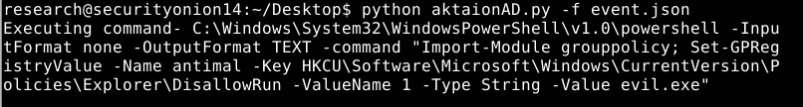
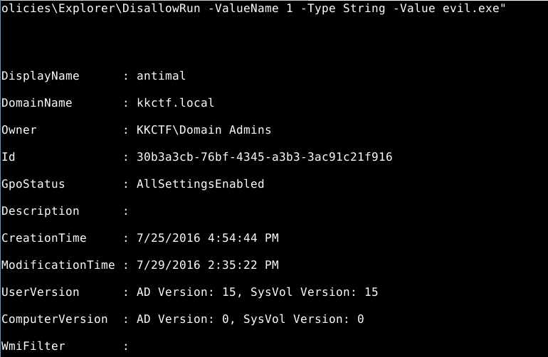
- Ransomware prevention items (Risk Scores --> GPO, ACLs)

Slide 72
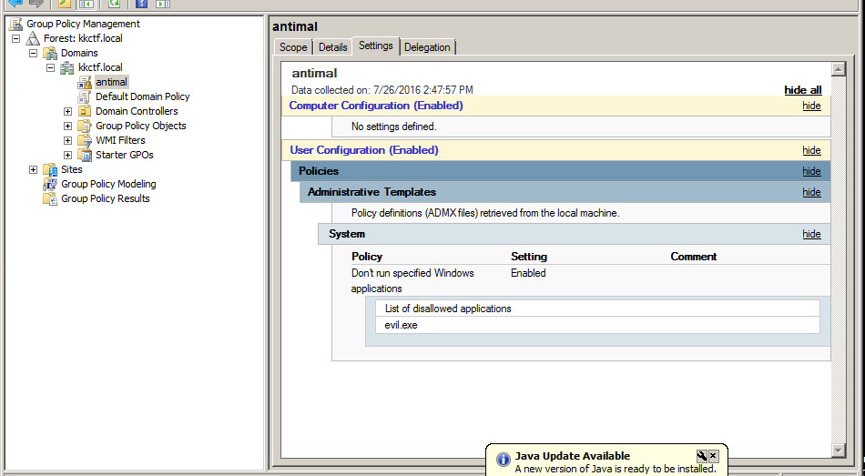
Ransomware prevention items (Risk Scores --> GPO, ACLs)

Slide 73
Active Defense
Output can be used to further application of defensive measures such as:
- ACL
- Group Policy in Windows Active Directory
- Blacklists
- Snort
- Bro signatures

Slide 74
- Conclusion
Use of Machine Learning techniques can enhance detection and defense technologies.
Signature less approach is the way of the present/future as conventional static signature based approach is insufficient
Use of Behavioral Analytic techniques provides an expansion into multiple items previously not considered in detection and defense technologies.
Combination of Machine Learning/Analytics streamlines analysis and detection when processing multiple sources of events or multiple micro behaviors present in individual events.

Slide 75
THE FUTURE CHIRON HOME BASED ML IDS
Chiron combines analytics with machine learning.
Designed for home networks, place with no or limited vision and very vulnerable
Aktaionv2 is will be the ML engine behind threat detection

Slide 76

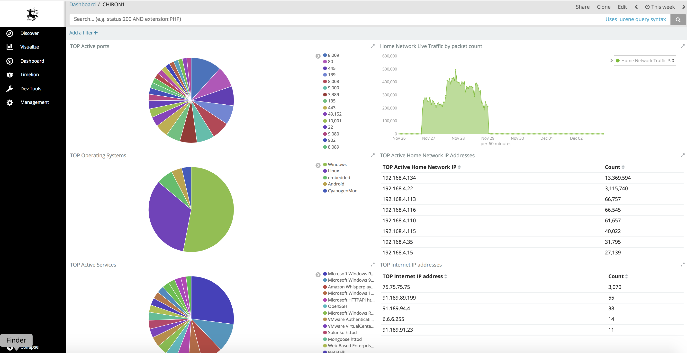
POC - Screenshots

Slide 77
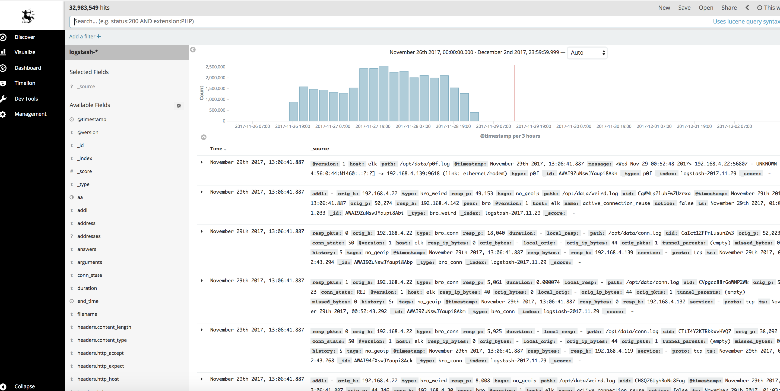
POC Screenshots

Slide 78
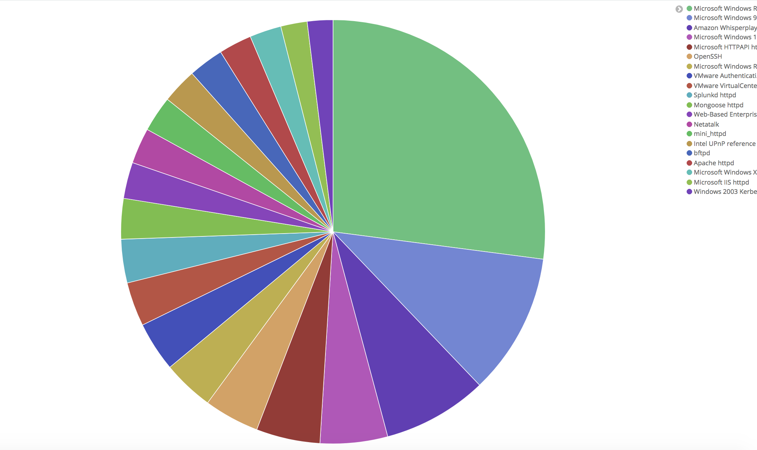
POC Screen shots

Slide 79
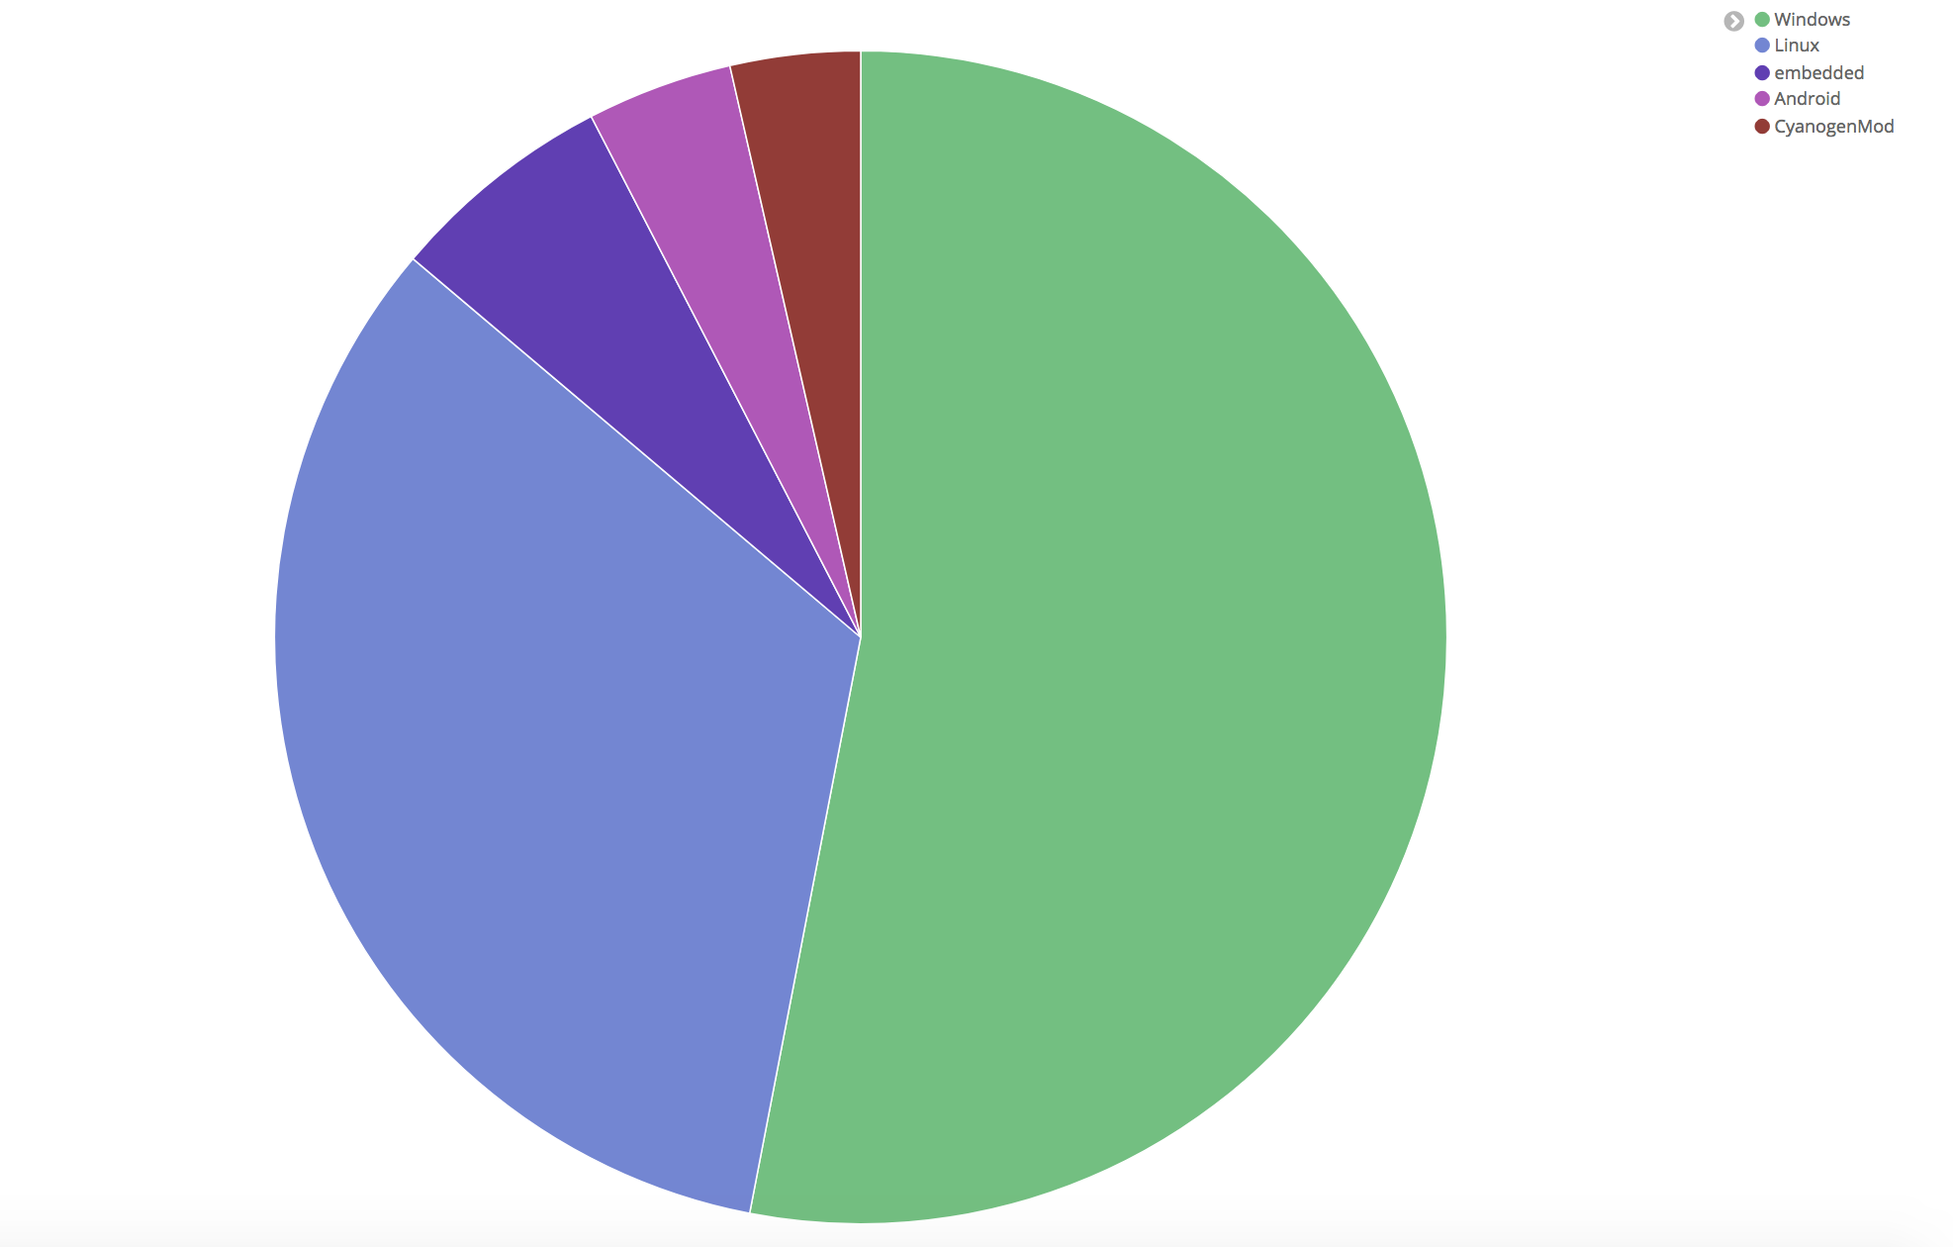
POC Screenshots

Slide 80
Q&A
Joseph Zadeh @josephZadeh
Rod Soto @rodsoto

Slide 81
Appendix

Slide 82
C2 Model
Adaptive Filter (Crowd sourced Popularity Metrics)
External Domain/IP Profile
Data In
Timing Features
Lexical Analysis
Communication Stats
Example: Variance of Inter-arrival Times
Example: N-Gram Score
Ratio of Bytes In/Bytes Out
Global Evidence Collection
Forensic Enrichment and Score Normalization
Human Feedback Loop
Classification Algorithm
Domain | Communication Score | Timing Score | Layer 7 Score | NLP Score | Analyst Recommendation
www.evil.com | High Risk | Moderate Risk | Moderate Risk | No Risk | Critical Priority: Communication is active and going unblocked
www.khhjdkshj33ejj.com | 0 | Moderate Risk | 0 | High Risk | Low Priority: Traffic is blocked by firewall
www.google.com | No Risk | No Risk | No Risk | No Risk | No Action Needed

